Slide 1
Multi-Body Kinetics
Dr. Jacob Moore
Associate Professor of Engineering
Penn State Mont Alto

Slide 2
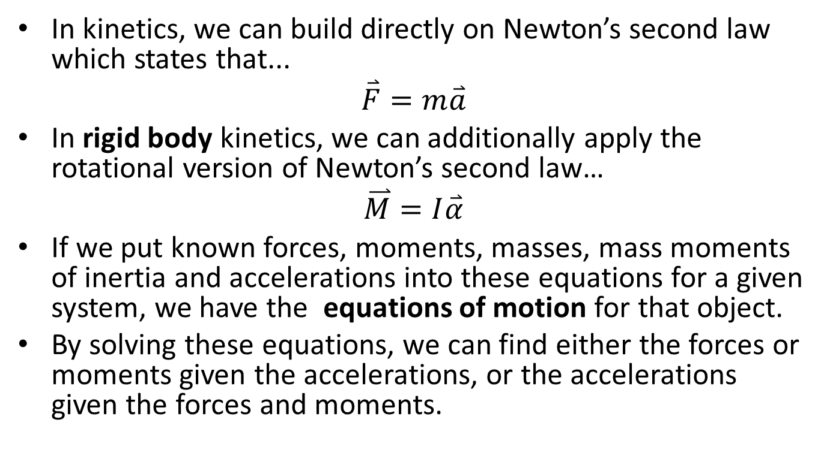
Newton’s Second Law and Kinetics
In kinetics, we can build directly on Newton’s second law which states that...
$$\overset{⃑}{F}=m\overset{⃑}{a}$$
In rigid body kinetics, we can additionally apply the rotational version of Newton’s second law…
$$\overset{⃑}{M}=I\overset{⃑}{α}$$
If we put known forces, moments, masses, mass moments of inertia and accelerations into these equations for a given system, we have the equations of motion for that object.
By solving these equations, we can find either the forces or moments given the accelerations, or the accelerations given the forces and moments.

Slide 3
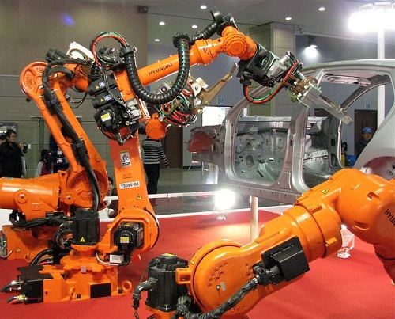

General Planar Motion in Multi-Body Systems
General planar motion refers to instances where a body is both translating and rotating at the same time.
In multi body systems we have a system where the pieces are connected, but the system will also allow for some relative motion.

Slide 4
Kinematics
Multi-body kinetics problems will also often require you to solve the kinematics equations using relative motion analysis, absolute motion analysis, or rotating frame analysis before you can solve for the forces.
Use whichever method is easiest for you.
We will need to know the acceleration and angular acceleration of the center of mass of each body in the system.

Slide 5
Multi-Body Systems
The core of analysis of multi-body systems generally is breaking the multi-body system into individual components and analyzing each component separately.
Each piece will have its own free body diagram and equations of motion.

Slide 6
Newton’s Third Law
Some pieces may have more unknowns than we can initially solve fore, but what ties everything together, is that Newton’s Third Law ensures that forces are equal and opposite at the connection points.
B
A
C
F_{AY}
F_{BY}
M_{A}
M_{B}
M_{B}
F_{BX}
F_{AX}
F_{BX}
A
B
B
C
F_{BY}

Slide 7
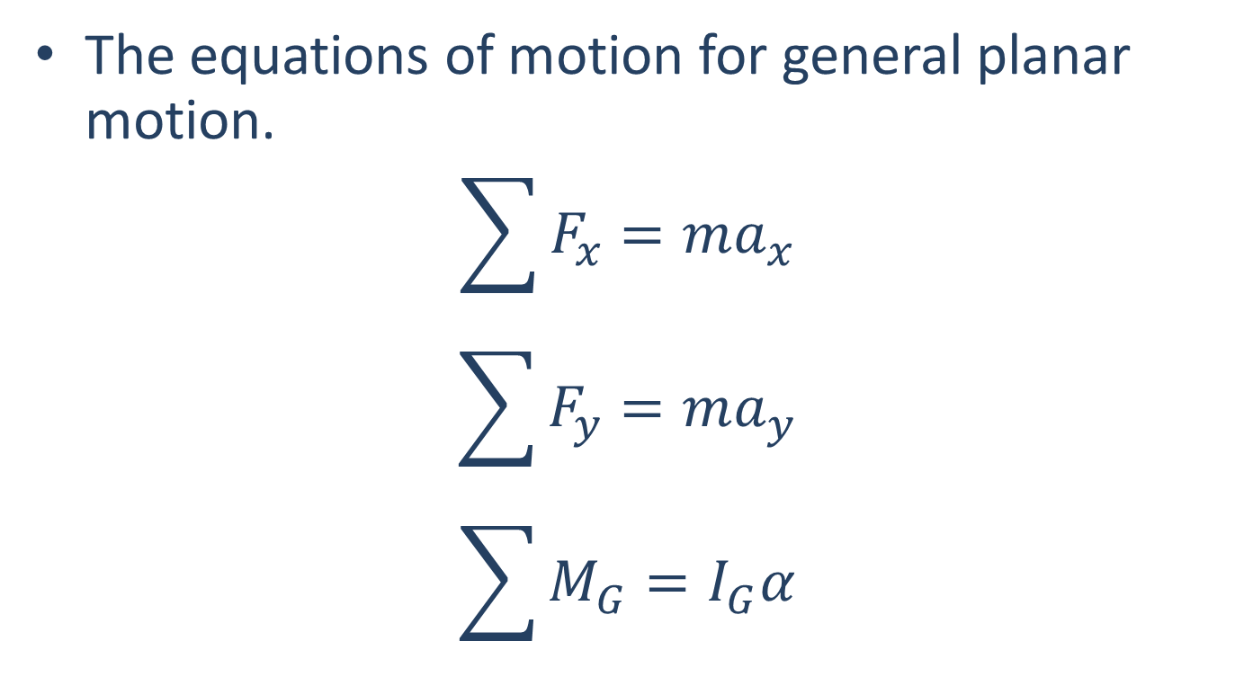
The Equations of Motion
The equations of motion for general planar motion.
$$\sum{F_{x}=ma_{x}}$$
$$\sum{F_{y}=ma_{y}}$$
$$\sum{M_{G}=I_{G}α}$$
Refers to the acceleration of the center of mass of the body
These should both be about the center of mass

Slide 8
Solving a Multi-Body Kinetics Problem (The Process)
Set up and solve the kinematics problem to determine the accelerations and angular accelerations for the center of mass for each component.
Set up a free body diagram for each component.
Draw each body separated from its surroundings and the other pieces of the system
Draw in all the known and unknown forces (I use red for forces) as well as key dimensions and angles (I use blue for dimensions and angles)
Make sure to have equal and opposite forces where the pieces are were connected
Draw in the acceleration vectors for the center of mass of each piece (I use a blue dashed vector for this)
Use the free body diagram to write out your equations of motion, breaking all forces down into x and y components, and writing out all the moments about the center of mass of the body.
Solve the equations for any unknowns.

Slide 9
Thanks for Watching
See other engineering mechanics videos and access the full tool at…

Slide 10
Worked Example
A robotic arm has two sections with the left section having a mass of 10 kg and the right section having a mass of 7 kg. Treat each section as a slender rod. If we wish to accelerate the left section from a standstill at a rate of 3 rad/s² and keep the right section stationary, what moments must we exert on the shoulder (O) and elbow (A) joints?
.6 m
.5 m
O
A
B
3 rad/s²

Slide 11
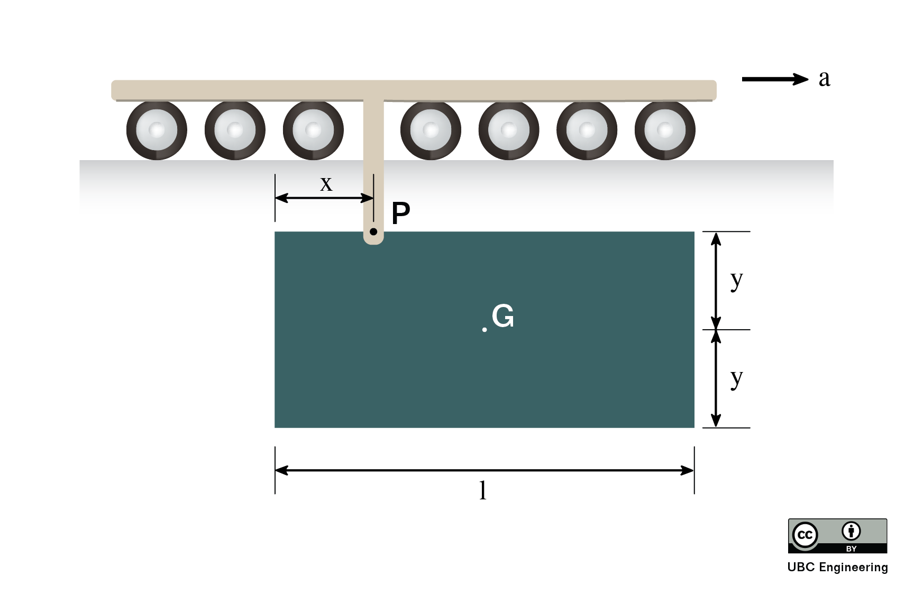
Worked Example
An engineering student is testing a component of her vehicle for a design competition. The 5kg rectangular plate is pinned to a carriage at P. If the track is given an acceleration of 2m/s^2, determine the reaction forces at P and the angular acceleration of the plate. The height of the plate is h=2y and G is located a vertical distance y=0.8m from P. The plate has a length l=2m and point P is a horizontal distance x=0.6m from the edge.

